Slide 1
Jayoti Vidyapeeth Women’s University,Jaipur India
Faculty Of Engineering and Technology
Review article on BOND PATTERNS AND BRICKWORKS
Jv’n Himanshi Niwal

Slide 2
Content
Introduction
Bond
Types Of Bond
Conclusion

Slide 3
Introduction
Bonding is the association of bricks in a structure along with a wall or column. Very widely, bricks may be laid as infantrymen (status upright), stretchers (laid lengthwise alongside the wall) or headers (laid width smart alongside the wall).

Slide 4
Bond
Bricks are normally laid to an offset pattern to maintain an adequate lap between joints from one route to the next and to make sure that vertical joints aren't positioned above each other on consecutive publications.
Brick bonding patterns:
▪ Distribute masses throughout the shape to gain most strength.
▪ Ensure stability.
▪ Achieve the favored aesthetic.

Slide 5
Types Of Bond
The phrase bond, when used in connection with masonry, may also have three meanings:
Structure bond
Pattern bond
Mortar bond

Slide 6
Structure Bond
The method by which individual masonry units are interlocked or tied together to cause the entire assembly to act as a single structural unit.
There are 6 primary structural bonds normally used nowadays which create normal styles.
These are: Running bond, common or American bond, Flemish bond, English bond and block or stack bond, English Cross or Dutch bond.

Slide 7
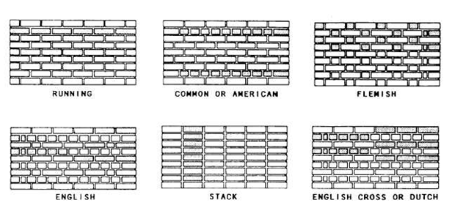

Slide 8
Pattern Bond
The pattern formed by the masonry units and the mortar joints on the face of a wall. The pattern may result from the type of structural bond used or may be purely a decorative one unrelated to the structural bonding.

Slide 9
Mortar Bond
The adhesion of mortar to the masonry units or to reinforcing steel.
The mortar serves four functions:
It bonds the units together and seals the spaces between.
It compensates for dimensional variations in the units.
It bonds to and, therefore, causes reinforcing steel to act as an integral part of the wall.
It provides a decorative effect on the wall surface by creating shadow or color lines

Slide 10
Conclusion
Bond is the arrangement of bricks in coarse, so that the bricks are tied together and the vertical joints of the successive courses do not come in the same vertical line. Defective arrangement of bricks reduces the strength and durability of the structure. A wall having continuous vertical joints does not act as a homogeneous mass to distribute the superimposed load.
Rules for bonding for the getting good bond, the bricks should be uniform size and to obtain uniform lap. The length of the bricks should be twice its width plus one joint.

Slide 11


